Slide 1

Project: Analyze NYSE Data
By: Kevin Darmasaputra

Slide 2
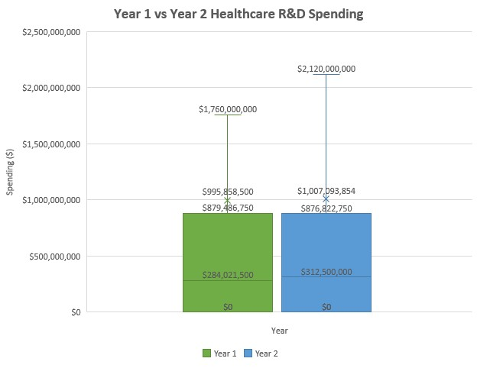
How does healthcare industry spending on R&D evolved from the 1st year to the 2nd year?
These are the box plots that shows the spending on R&D by the healthcare industry sector from all the companies in NYSE.
The box plots shows the R&D mean of the 2nd year is more than the R&D mean of the 1st year by about $12 million. This shows the healthcare industry is more serious and trying to invest more on the development.
The mean for the R&D expenses of the 1st year is about $995 billion and it is slightly increased to $1.007 billion. The median for the 1st year ($284 million) increased by $28.5 million to $312 million on the 2nd year. The standard deviation for the first year is $1.85 billion which is very much higher than the mean value of the 1st year. That tells the company R&D spending in the Healthcare sector is scattered. The same thing happened in the 2nd year where the standard deviation was $1.75 billion.
The range for the 1st year is $8.17 billion, while the range for the 2nd year decreased to $7.5 billion. This is interesting considering the median and the mean increased from the 2nd year. This shows that most of the companies in the healthcare industry increase their overall R&D spending.

Slide 3
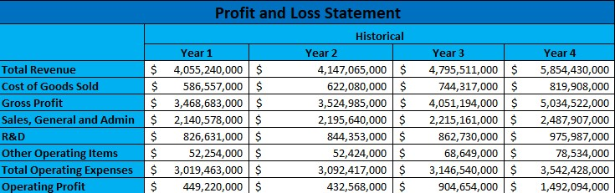
Profit and Loss Statement of Adobe Inc. from the 1st Year to the 4th Year
We can see from the Profit and Loss Statement below that the gross profit of Adobe Inc. has increased considerably during the four years.
The gross profit only increased by $56 million in the 2nd year which is 1.6%. But in the 3rd year it saw an increase of $526 million or 15% compared to the 2nd year. The 4th year it registered the highest gross profit of all the years before with $983 million, which is an impressive 24% increase compared to the 3rd year.
The operating profit of Adobe Inc. was not stable throughout the years. The operating profit registered $449 million in the first year. But it went down to $432 million in the 2nd year. Going onto the 3rd year it doubled the profit to $904 million. Things kept improving on the 4th year with a spectacular $1.5 billion operating profit, which is more than 1.5x the previous year.

Slide 4
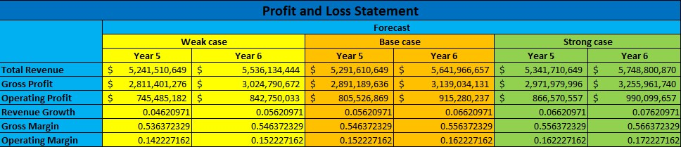
Forecasted Profit and Loss Statement of Nvidia Corp. for the Next 2 years
Eventhough the 1st to 2nd year revenue growth of Nvidia Corp. is negative, the forecasted profit and loss statement shows an increase of revenue growth, thanks to a stellar year 3 and year 4 growth. The revenue growth is expected to increase by 7% and 8% in year 5 and year 6 for the best case scenario. In the base case scenario the revenue growth is expected to increase by 6% and 7%. While in the weak case scenario, the revenue growth is expected to increase by 5% and 6%.
The gross margin is expected to increase in 5th and 6th year by 56% and 57% in the best case scenario. In base case scenario, it is expected to increase by 55% and 56%. While in the weak case scenario, it is expected to increase by 54% and 55%.
The operating margin is expected to increase by 16% and 17% in 5th and 6th year in the best case scenario. In the base case scenario it is expected to increase by 15% and 16%. But in the weak case scenario it is expected to increase by 14% and 15%.

Slide 5

Thank you!

